Slide 1





Web Map
Get started
25 April 2018 Developer Workshop

Slide 2




Agenda
Prepare Data
Develop Web App
Exercise

Slide 3

Prepare Data
ArcGIS Online

Slide 4
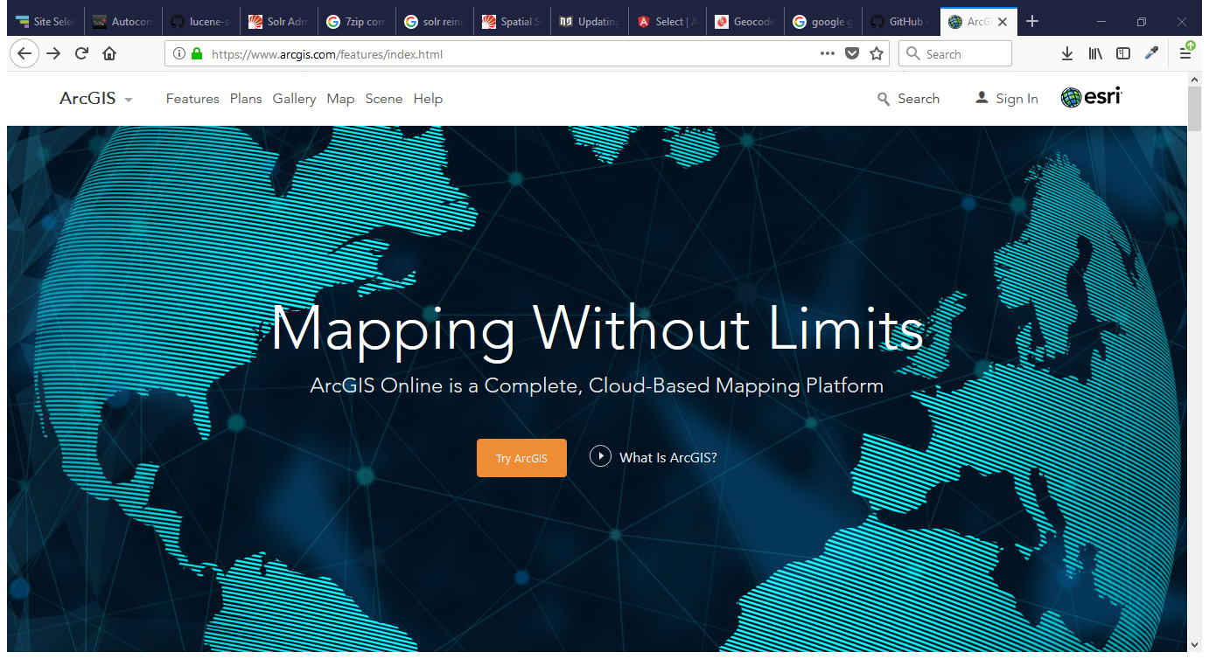
ArcGIS.com

Slide 5
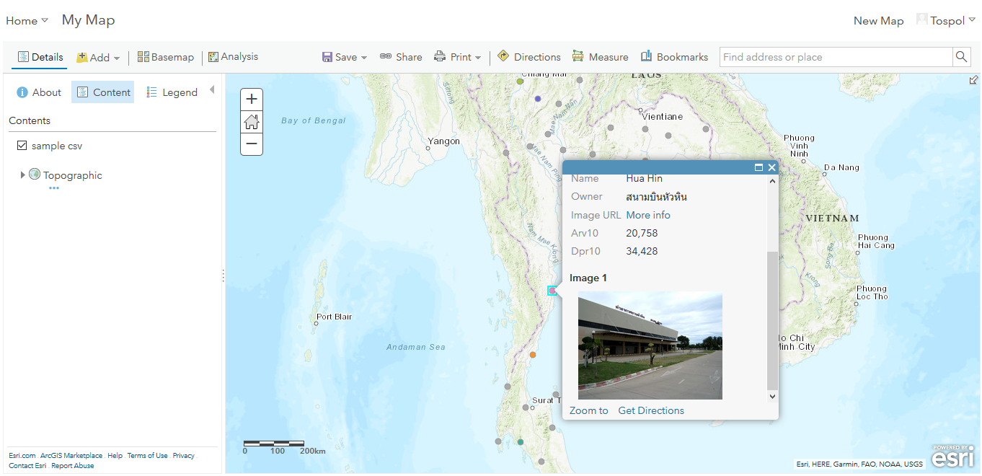
Content & Map

Slide 6
Resources Link
https://github.com/tospol/Developer-workshop-1

Slide 7
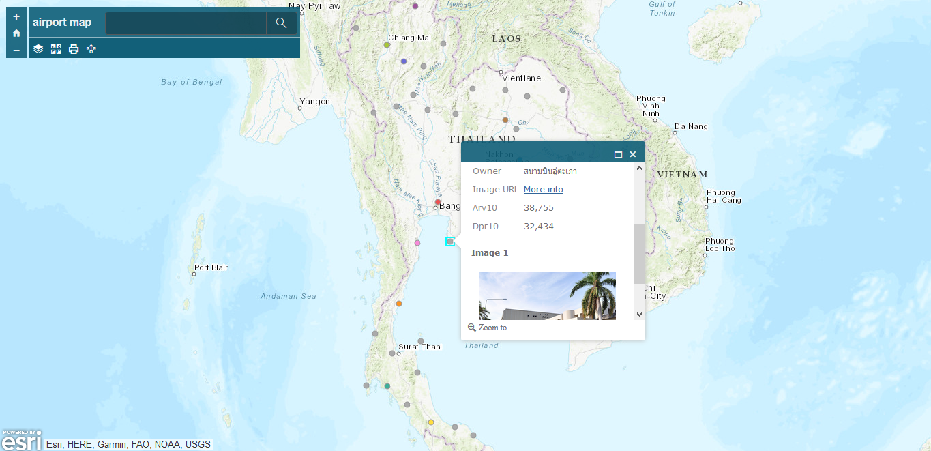
Ready to use App

Slide 8
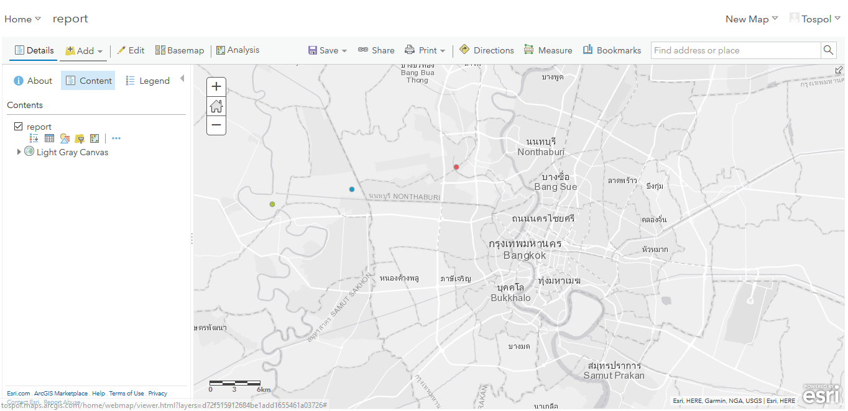
Create your data

Slide 9
Create your data
Content > Create > Feature Layer
Choose template
Manage fields (Data tab)
Add sample data
Configure Visualization

Slide 10
Develop Web App
ArcGIS API for JavaScript

Slide 11

Developers.ArcGIS.com

Slide 12
Mapping Concept
Layers
- GraphicLayer
- FeatureLayer
- Basemap
Map
Feature/Graphic
- Geometry
- Attributes
- Symbol
Geometry ⬄ Symbol
- Point ⬄ SimpleMarker, PictureMarker
- Polyline/Line ⬄ SimpleLine
- Polygon ⬄ SimpleFill

Slide 13
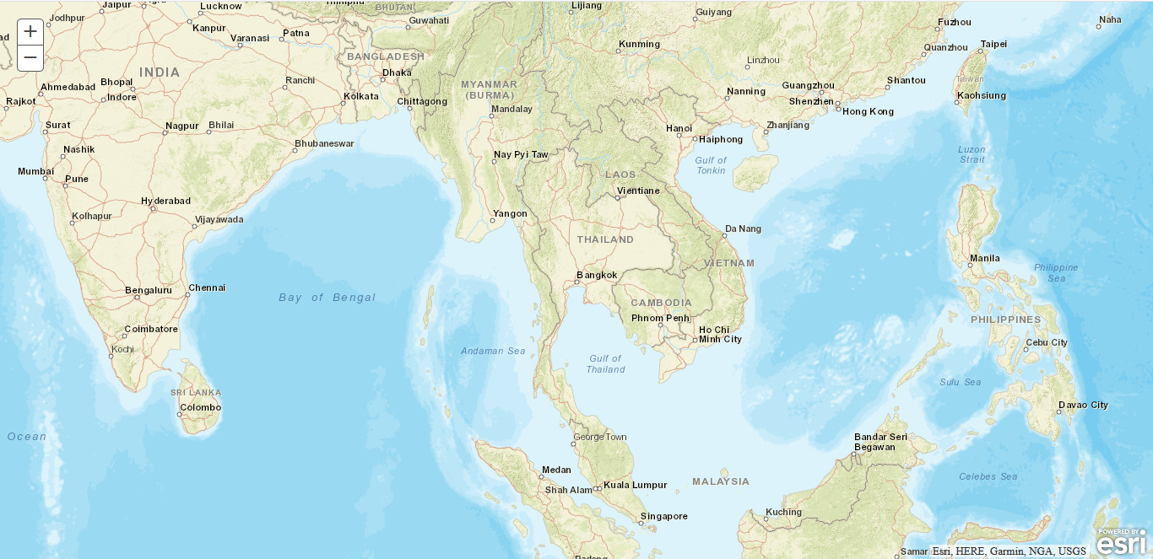
Hello World

Slide 14
Hello World
Create a Simple HTML Document
Reference the ArcGIS API for JavaScript
Load Modules
Ensure the DOM is Available
Create the Map
Define the Page Content
Style the Page

Slide 15
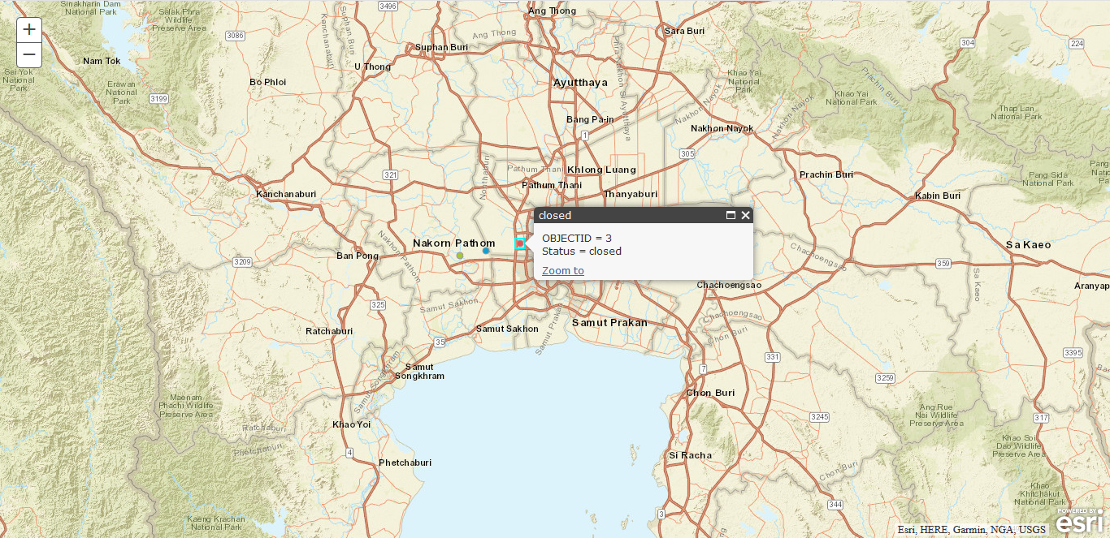
Add Layer

Slide 16
Add Layer
FeatureLayer
InfoTemplate
Map
addLayer method

Slide 17
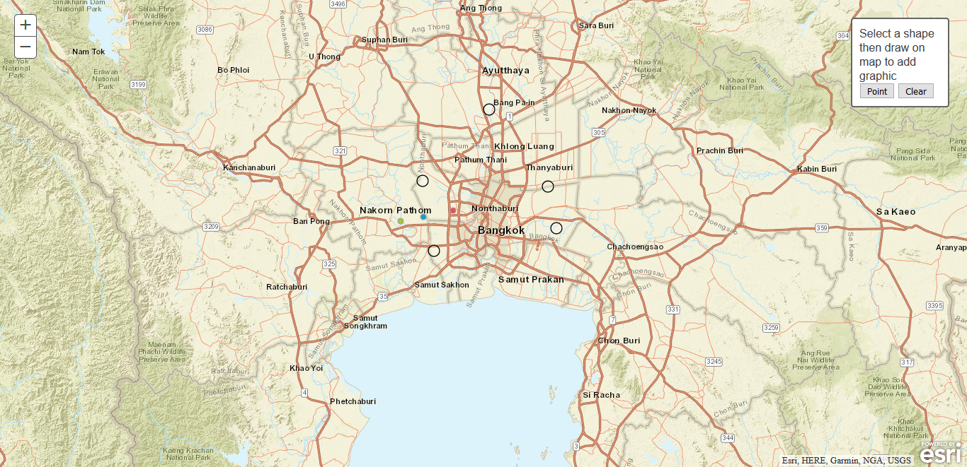
Add Graphics

Slide 18
Add Graphics
Graphic
Geometry
Symbol
Map
graphics property
GraphicsLayer
add method
clear method

Slide 19
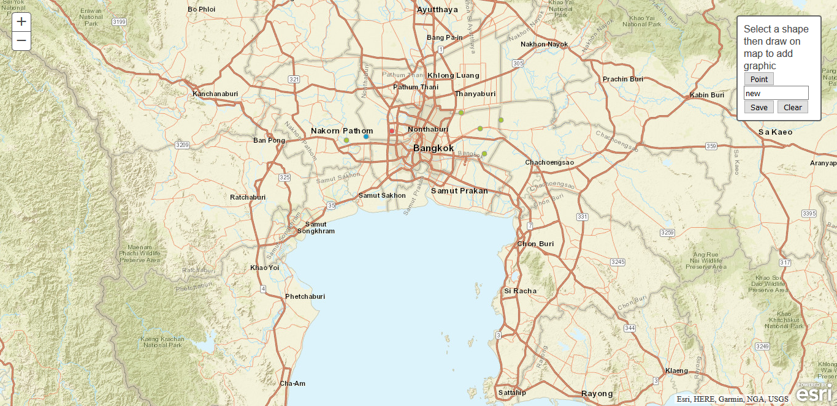
Add Data

Slide 20
Add Data
FeatureLayer
applyEdits method
refresh method
Graphic
geometry
attributes
clone method
setAttributes method

Slide 21

THANK YOU
Developer Workshop
25 April 2018

